Slide 1
Tropical Neural Networks
LT Kurt Pasque, USN
Operations Research Student
Research Team
Dr. Ruriko Yoshida, OR Department, NPS
Dr. Jefferson Huang, OR Department, NPS
Dr. Keiji Miura, Kwansei Gakuin University
Maj Christopher Teska, OR PhD Candidate, USMC

Slide 2
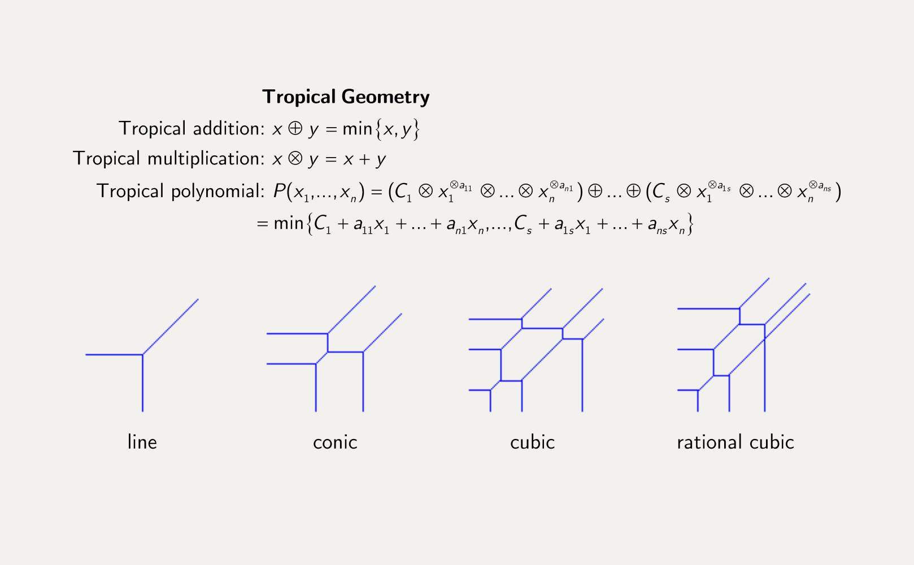
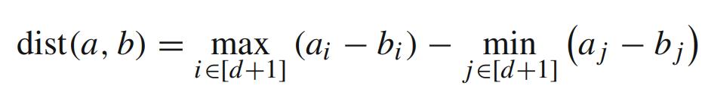
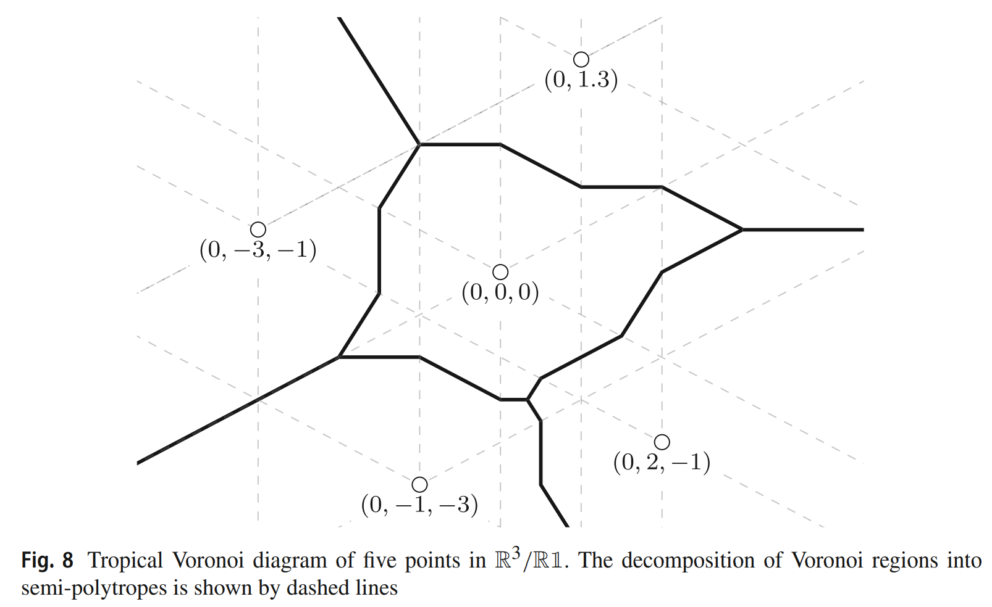
Introduction
BACKGROUND
Tropical geometry is a field of mathematics that has been shown in recent years to have properties applicable to neural networks. Dr. Yoshida and collaborators recently showed that how to embed “tropical layers” within neural networks and that this structure has applications to phylogenetic tree classification.
WHAT IS TROPICAL GEOMETRY?
RESEARCH QUESTION
Can we use tropical layers embedded in neural networks to make the network more robust to perturbed input data?
Source: Criado, Joswig, Santos, “Tropical Bisectors and Voronoi Diagrams”
Notes:
Valuation algebra, less exact version of log, geometry piecewise linear and can still approximated

Slide 3
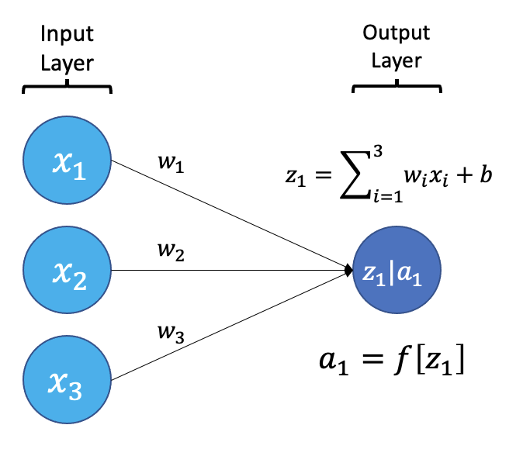

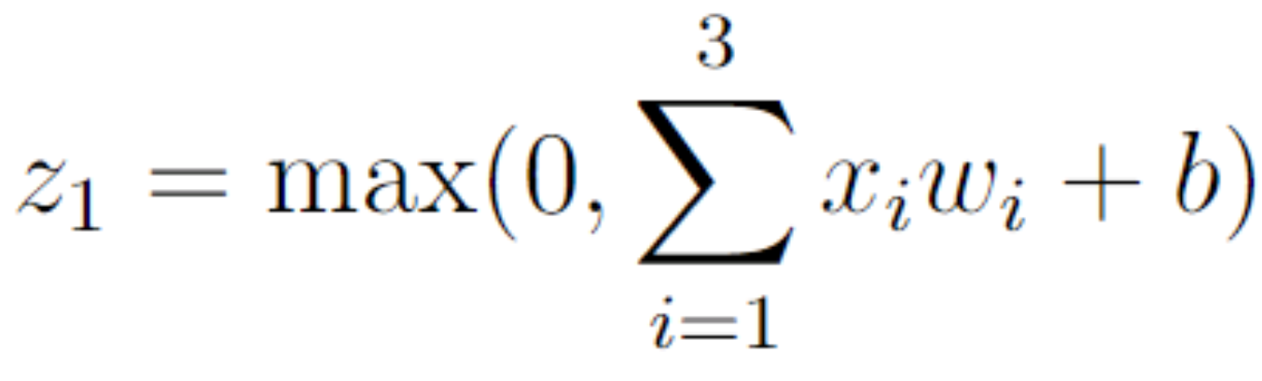
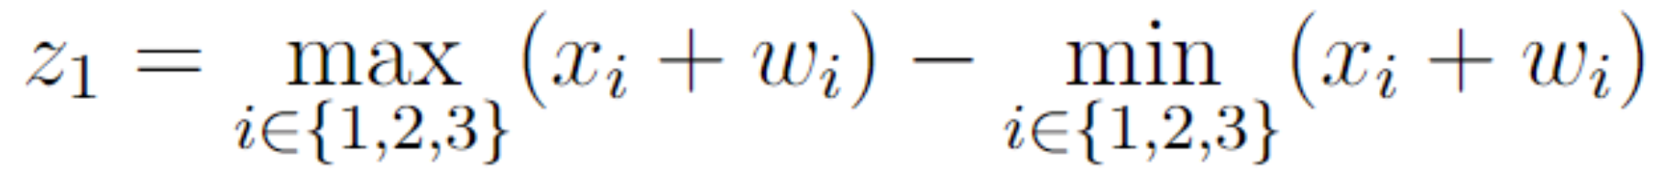
Tropical Layers
How ReLU-Activated Neural Network Layers Work
How our Tropical Neural Network Layer Works
Notes:
Z_1 tropical norm, distance from tropical distance, projecting onto mod1 space

Slide 4
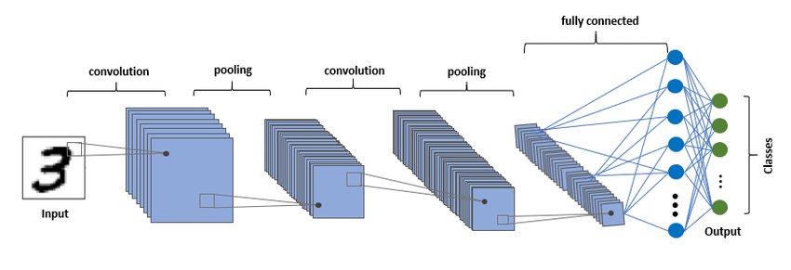


Experiment
EXPERIMENT
Train 2 identically structured models (1 w/ ReLU activations, 1 w/ LAST layer Tropically activated) on a training set.
Attack test set using projected gradient descent attack.
Evaluate model accuracy on test set pre/post attack.
Repeat for 3 open-source, benchmark datasets.
MODEL STRUCTURES
Similarities: Convolutional Neural Network (CNN) w/ 3 convolutions followed by 2 fully connected layers. ReLU activations for all layers except the last layer.
Differences: Last layer (that produces the logits) for tropical network uses tropical neurons.

Slide 5
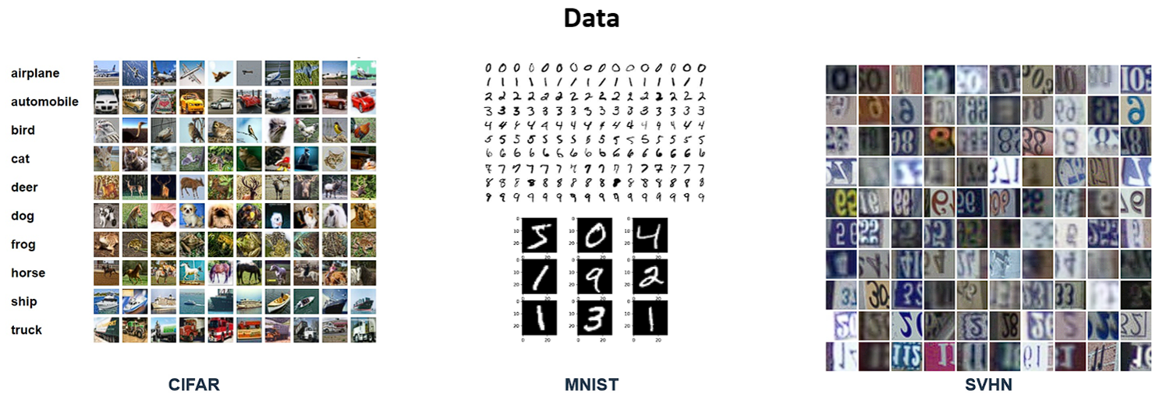

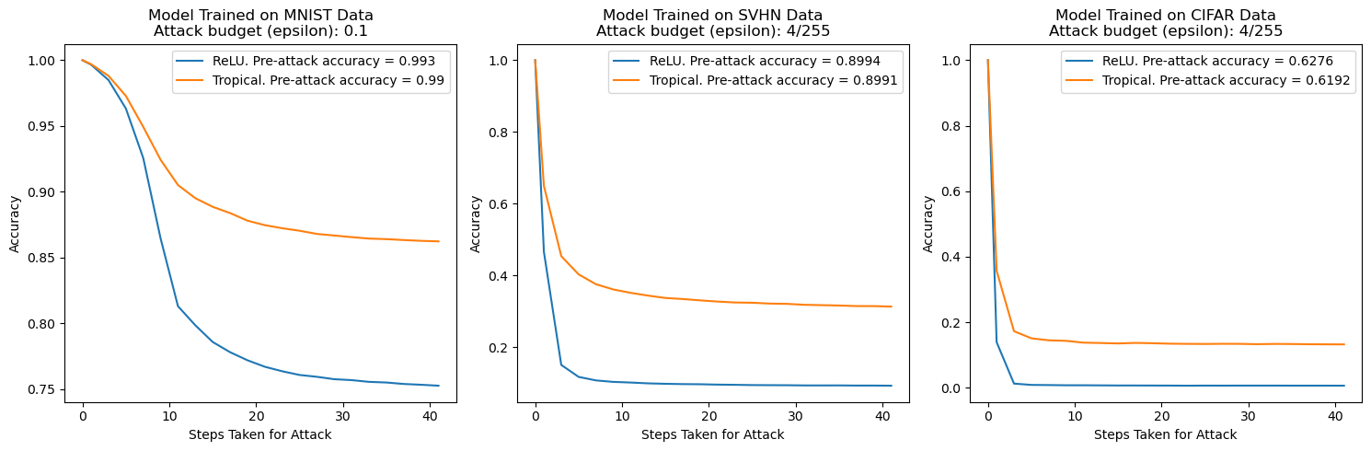
Data + Results

Slide 6
To Do’s
More experiments with different attacks.
Finish writing paper w/ advisor team and other collaborators.
Clean up GitHub repository before making public.
Explore more neural network structures and regularization techniques.
We have engineered a tropical convolutional layer and 2 custom tropical regularizers, but not experimented with too much.
Applying this to new datasets for my thesis.

Slide 7
Backups

Slide 8
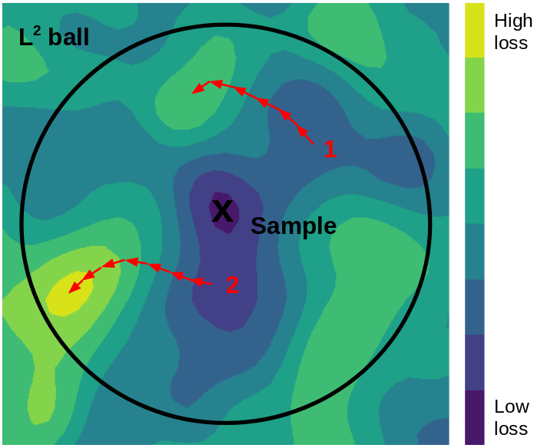
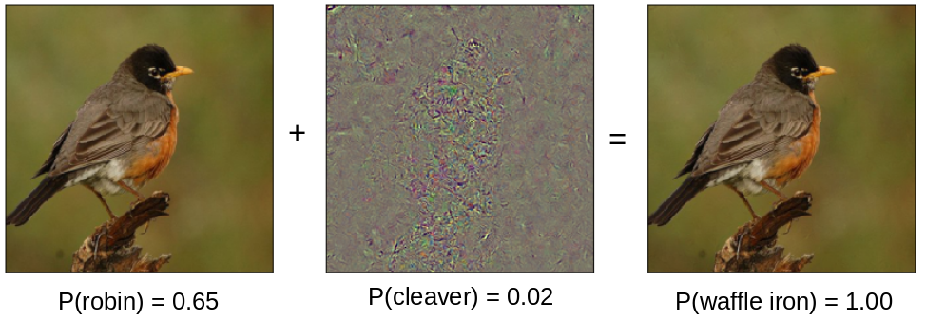
Attack Used
Projected gradient descent attack
Method:
Take a gradient step in the direction of greatest loss
Project perturbation back into L^p ball if necessary
Repeat 2–3 for user specified number of steps
Parameters we used:
Epsilon = 0.1 (In line with benchmark Chris found for MNIST)
Number of steps/iterations = 20 (reason for choice on next slide)
Step size = 0.01
Possible expansion: starting the attack from a random perturbation within the L^p ball like the visual on the right.
2-D visual where the starting point is a random place within L^p ball. Our method currently would start at the “x” in this visual and not 1 or 2:
Notes:
source:https://towardsdatascience.com/know-your-enemy-7f7c5038bdf3

Slide 9
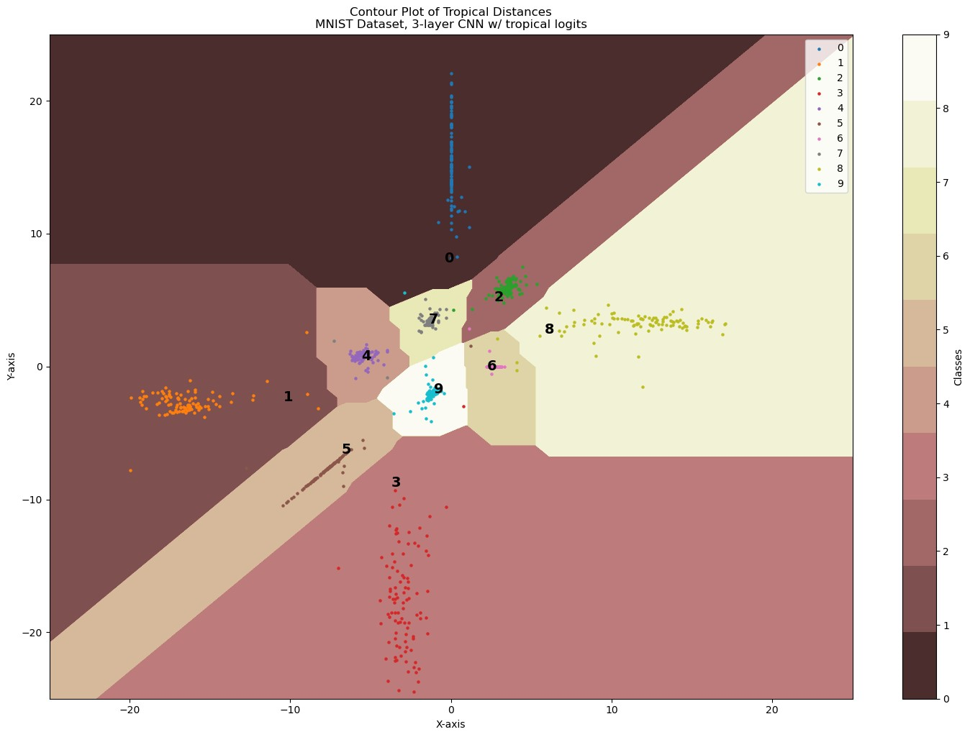
Decision Boundaries

